Slide 1

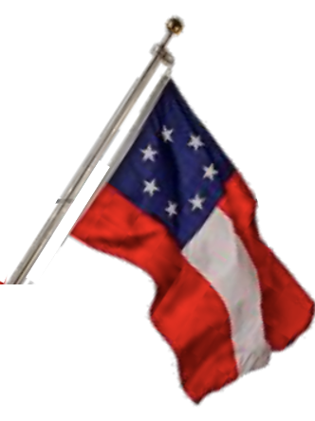
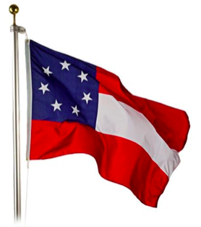
Virginia Division
Great-Great-Granddaughters Club
Spring 2025 Newsletter
District Conferences
The Southern Cause – by Duval Porter
Oh, Righteous Cause, for which we fought, And for which thousands died, We glory in it as we ought And point to it with pride. The Cause for which our fathers bled, In Revolution days, The right of self-defense instead Of treasonable ways. No "Cause" is "Lost" that has the right, Success is often wrong, Tho' seemingly it wins the fight, The honors still belong To those in failure or defeat, Who tried and did their best, As long as noble hearts shall beat Within a human breast. Was Russia right and Poland wrong Contending for its place, Among the nations, brave and long, 'Till crush'd by power base? The rev'rence all true Southrons feel, No foes can over-awe, For Cause that ever will appeal, With all the force of law. And yet today we are as true To country's flag as they, Who bore it then and wore the Blue 'Gainst those who wore the Gray.
Duval Porter was born in Appomattox County, Virginia
in 1844. Interested in writing from an early age, he
became a contributor to the local papers at the age of
fourteen. He was a Confederate veteran, author and
Newspaperman.
We are excited to have an
information table at the District Conferences.
Membership is important and honors the legacy of our Great-Great Grandfathers who fought in the War Between the States.
Please be sure to pay your annual $10 dues by June 1. Membership renews are on the Division web sites, or can be obtain from your chapter presidents.
Your $10 dues covers Division and General dues. PLEASE DO NOT SEND ANY MONEY TO GENERAL. The General dues must be sent by the Division Treasurer.
When submitting dues, please be sure to use the membership form and PLEASE be sure your email address is legible on the form. Emails are how we communicate news about the club.
They chose me,
My ancestors
chose me to
tell their stories,
unravel their truths,
and learn from their hardships.
They choose me
To inspire and encourage
others with their stories,
They chose me
To keep their possessions,
handle them with respect,
and share them with family.
My ancestors chose me.
- s. dickerson

Slide 2

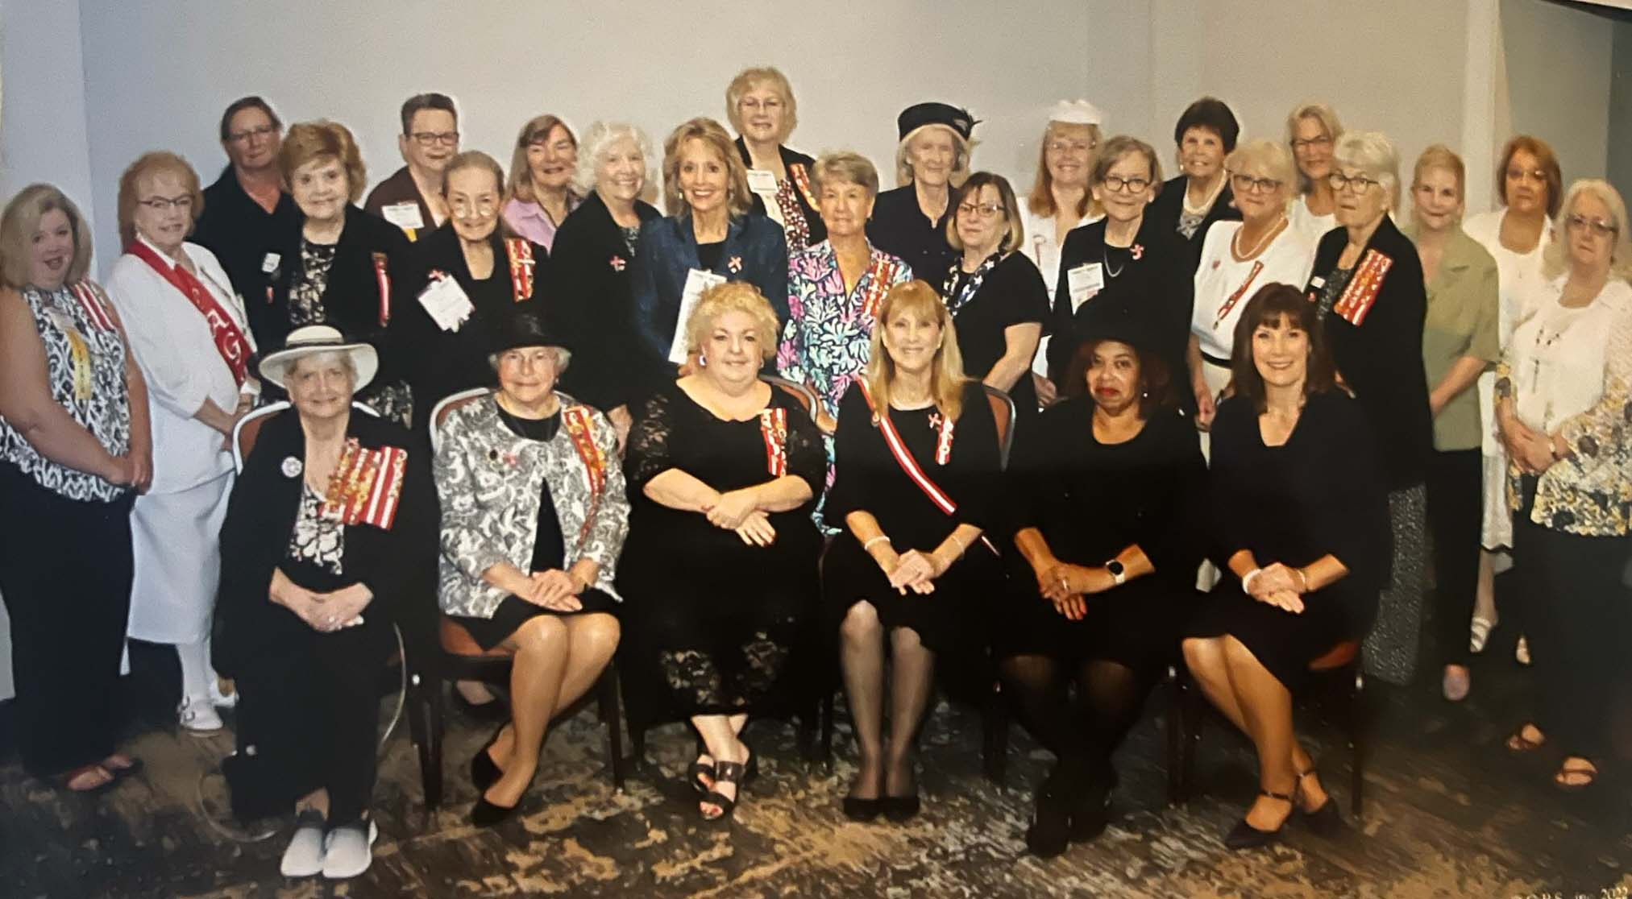
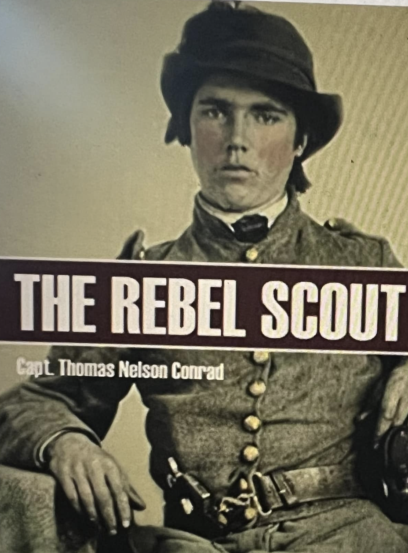
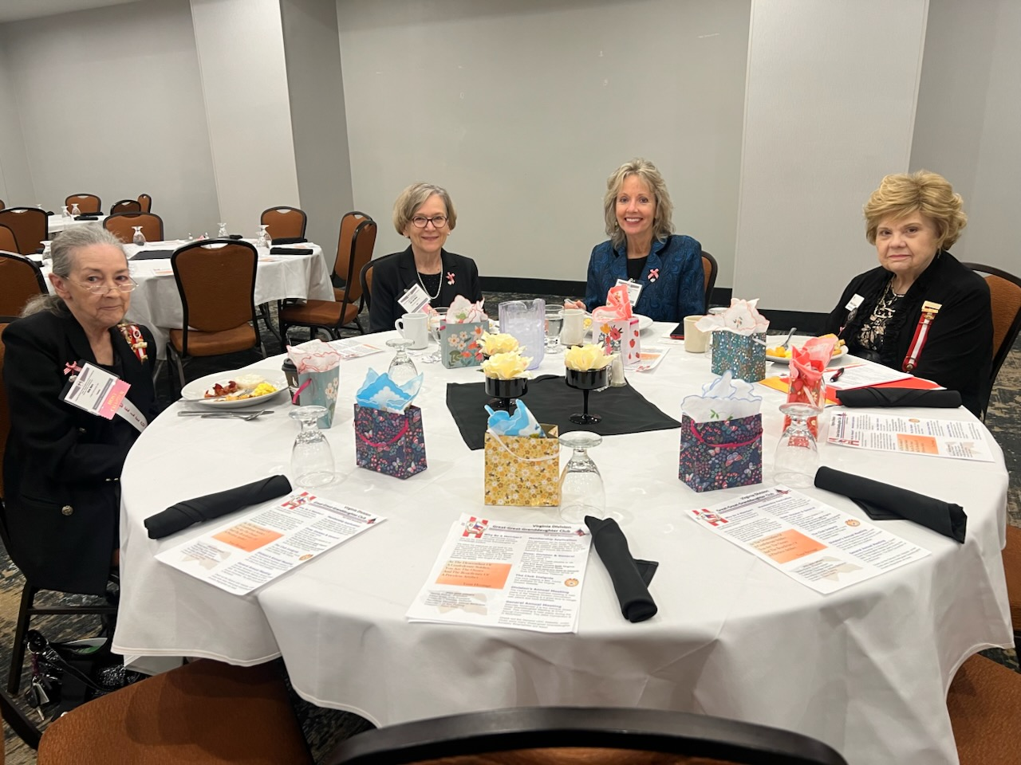
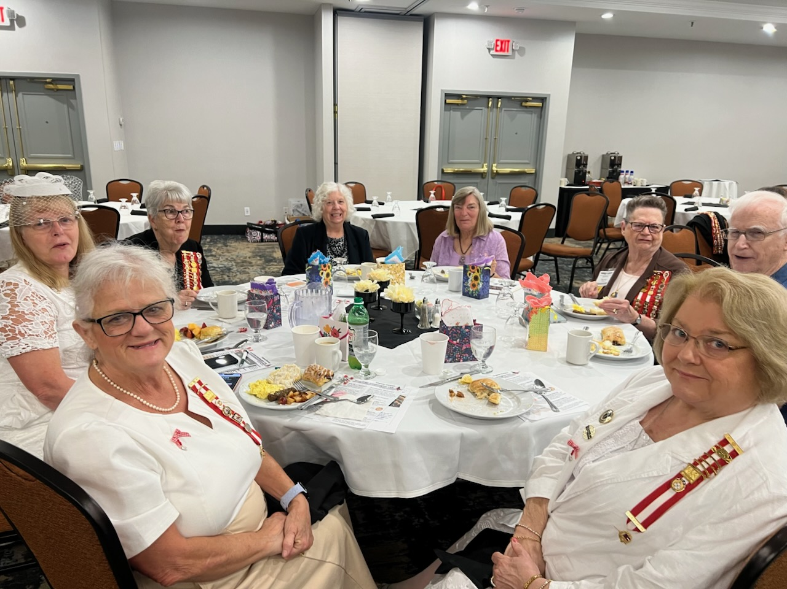
Book Corner - Author Thomas Nelson Conrad
Virginia Division
Great-Great Granddaughter
Club Breakfast
October 5, 2025
In 1861, Thomas Nelson Conrad enlisted as a chaplain in the Confederate army. Assigned as a scout for the 3rd Virginia Cavalry, the 24-year-old Methodist preacher often made use of his chaplain garb when crossing into Union lines.
Once Conrad began operating in Washington, D.C., he established a spy operation in the Van Ness house, a mansion owned by a Confederate sympathizer and located near the White House and government offices. A contact at the War Department aided Conrad’s efforts to acquire information about the composition `1 and movement of Union forces. Conrad also routinely forwarded Northern newspapers that provided accounts of Union Army activities to Confederate military leaders in Richmond.
The intelligence Conrad provided proved useful to the South in several major battles of the war. That included documents he furnished to Confederate General Robert E. Lee about Union Army activities during the Seven Days Battle in mid-1862, enabling Lee’s army to outmaneuver the stronger Union forces. Later that year, Conrad learned of Union Army plans to march south through Fredericksburg, Virginia, where Lee was headquartered. It was one of several reports Lee received about the advancing Northern forces, and in the subsequent Battle of Fredericksburg, the Confederates won their most lopsided victory of the war.
Conrad proved an elusive spy and often succeeded in evading arrest or escaping from his captors. Detained in August 1862 on charges of communicating with the enemy and recruiting soldiers for the Confederate Army, Conrad was sent to the Old Capitol Prison in Washington, D.C., from where he was later paroled. In late 1863, Lafayette Baker, the head of Union intelligence, moved to arrest the spy but was foiled when Conrad was tipped off by a Southern agent in Baker’s employ. The following year, Conrad was captured a second time and imprisoned in southern Maryland, but after feigning illness, he once again managed to escape.
In the fall of 1864, Conrad concocted a brazen plot to kidnap President Lincoln and exchange him for Confederate prisoners in the North. He abandoned his plans after finding the President too well-guarded. Ironically, Conrad was arrested a final time in April 1865 for suspected involvement in the assassination of Lincoln, merely because of his resemblance to John Wilkes Booth. He was later released.
Conrad’s espionage over the course of the war was so valued that Confederate President Jefferson Davis wrote him a personal note stating: “Please accept my thanks for the zealous and patriotic manner in which you have lately served the Confederacy by going within the enemy’s lines.” Conrad survived the war and later became an English professor—and eventually, president—at a college in Blacksburg, Virginia, the predecessor to the Virginia Polytechnic Institute (Virginia Tech). He died in 1883.
2023-2025 Officers
Teresa Roane - President
Karen Grigg -Vice President
Treasurer – Therese DeSanto
Recording Secretary- Milbrey Bartholow
Historian – Jo Ann Fickling
Chaplain – Dawn Diehl

